Slide 1
Product Line Optimization
@ GAM PHARM
by Backstreet Bayes Consulting Group

Slide 2
Table of Content
Introduction
Team
Process
Current State
Problems to Solve
Method & Analysis
Results
Outlook

Slide 3
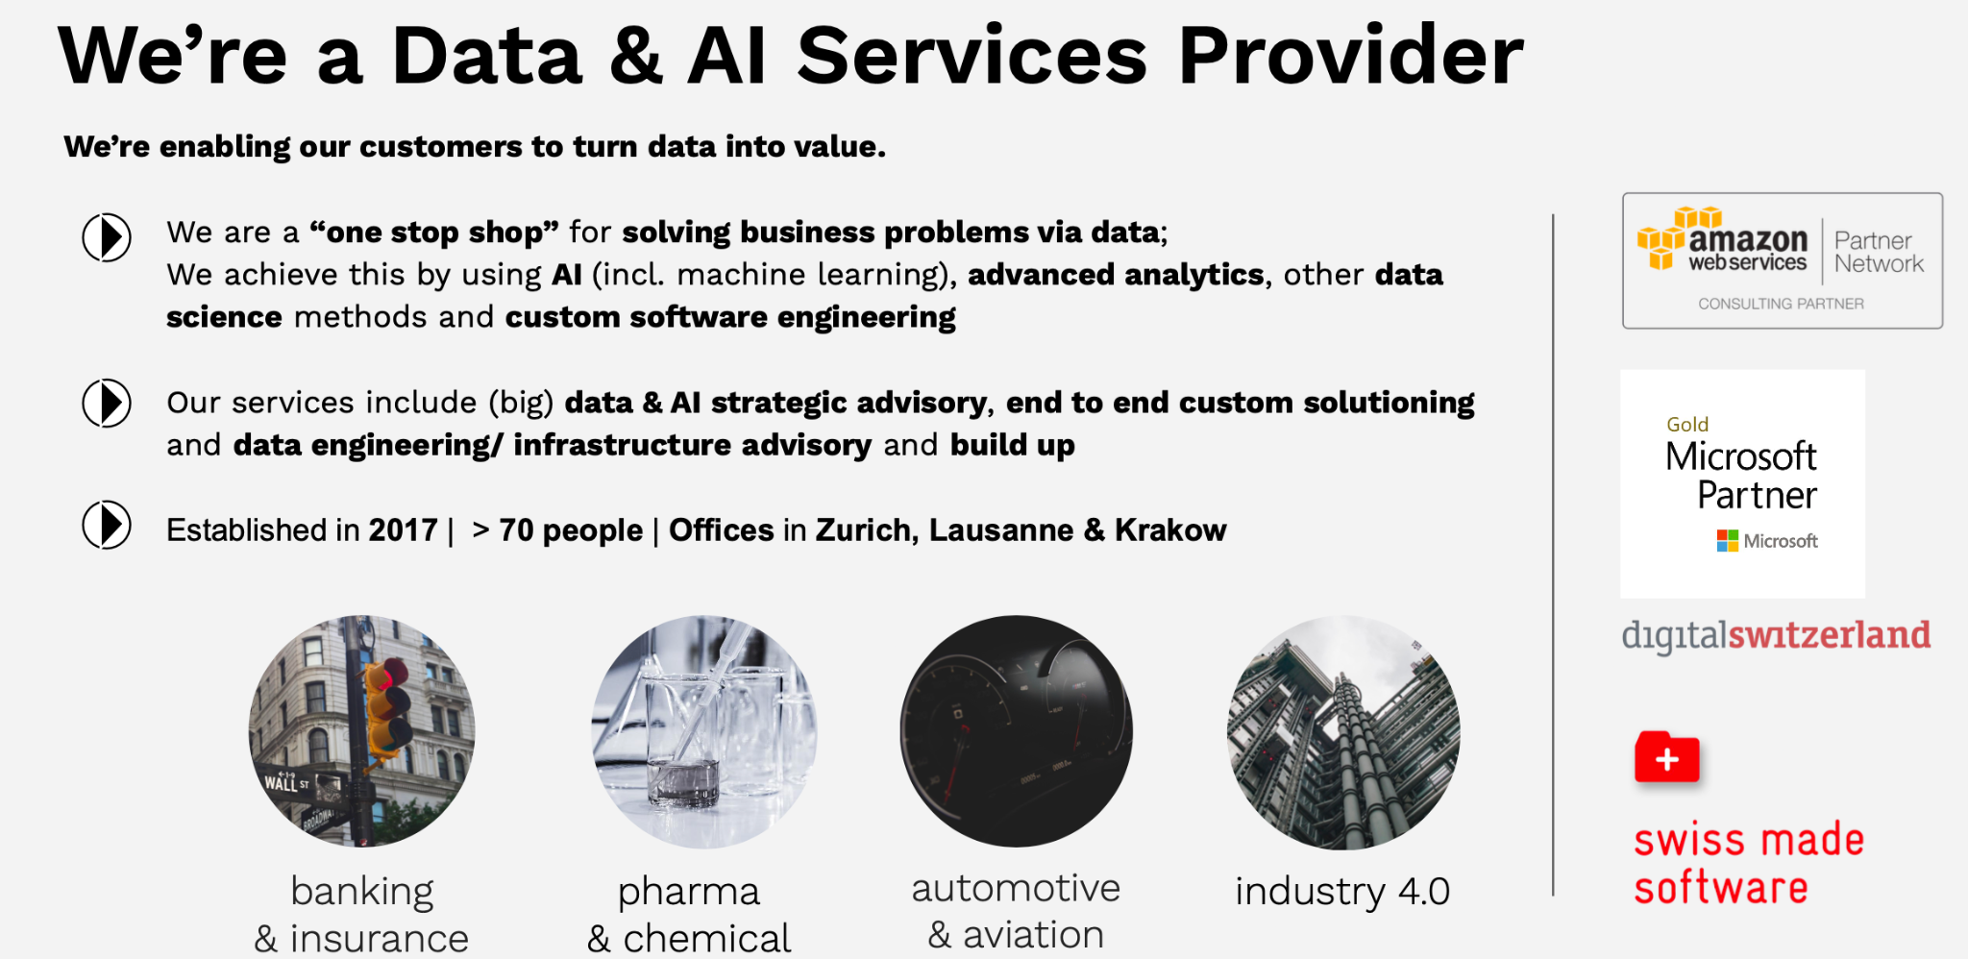
We are a Data & AI Services Provider
We are enabling our customers to turn data into value.
We are “one stop shop” for solving business problems via data; we achieve this by using AI, advanced analytics, other data science methods and custom software engineering.
Our services include (big) data & AI strategic advisory, end to end custom solutioning and data engineering/ infrastructure advisory and build up
Established in 2017 | > 70 people | Offices in Zurich, Lausanne & Krakow | formerly known as Backstreet Boys or Unit8

Slide 4
Mission
Our mission is to help non-digital companies, institutions and industries accelerate their digital transformation and fulfil their obligations toward business and society with data, Advanced Analytics & AI.

Slide 5

Team
Ken Geeler
HR-Guy
Flavio Eisenring
Backend
Marco Pereira

Slide 6
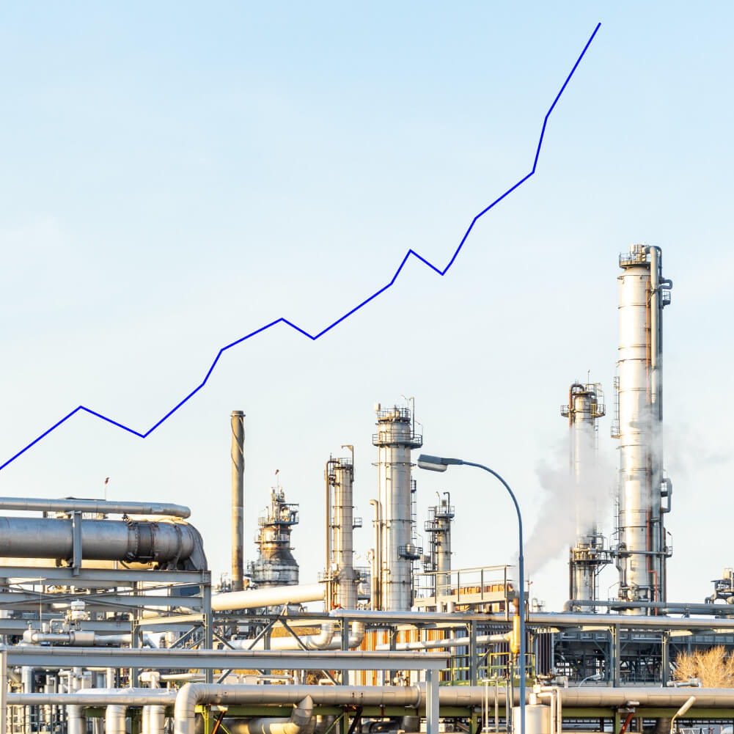
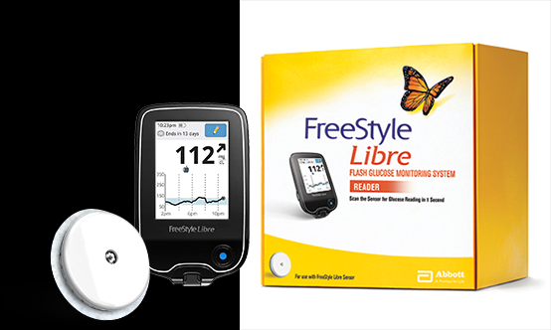
GAM Pharm
Increasing demand for flagship products (diabetes and aging of population)
Net sales increasing ⇔ production costs as well

Slide 7
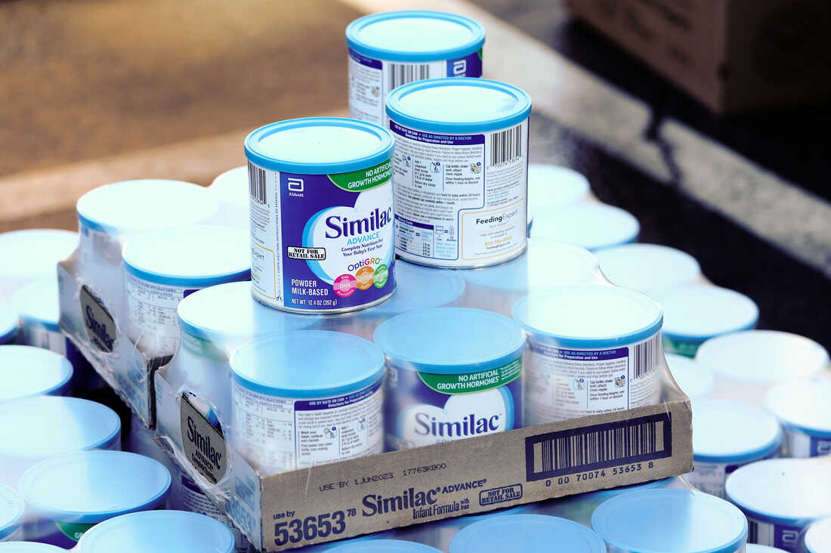
Problems to solve
Production costs:
Increasing demand leads to higher production costs
“Economies of scale”
1
2
Capacity limits:
Ramping up production leads to capacity limits being reached
Optimization needed to handle limited resources

Slide 8



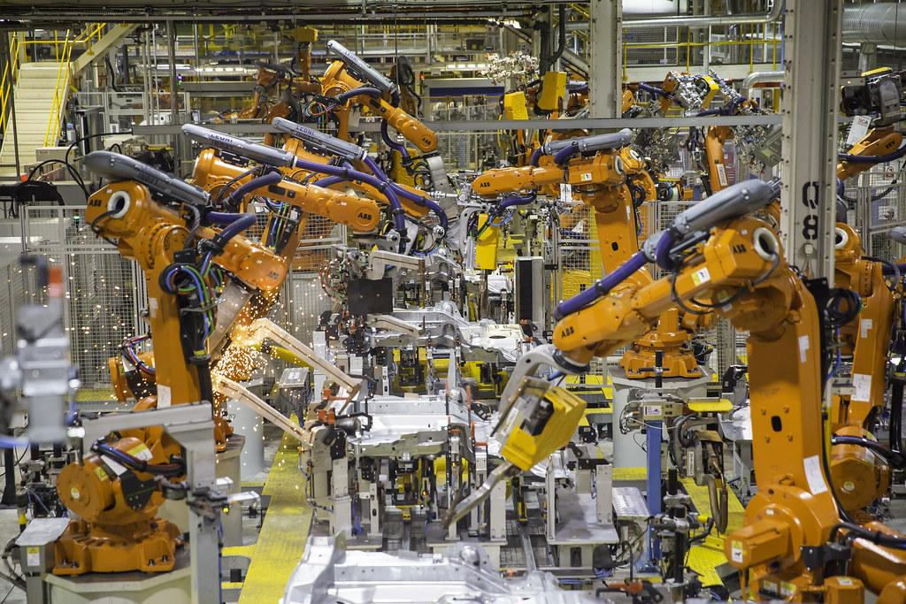
Process
Line B
Line D
Line A
Line C
6 Modules Bottleneck Module 4
4 Modules Bottleneck Module 3
3 Modules Bottleneck Module 2
7 Modules Bottleneck Module 1

Slide 9
Method & Analysis

Slide 10

Overview
Gathering Data
Simulation
Observation and Optimization
Testing of Optimal Solution
Visualization of the process for understanding
Extraction of production parameters from log file
Digital twin of production lines (Python)
Based on log file from real-world production
Randomized ordering of job sequence
Fixed position of specific jobs
Test and evaluation

Slide 11
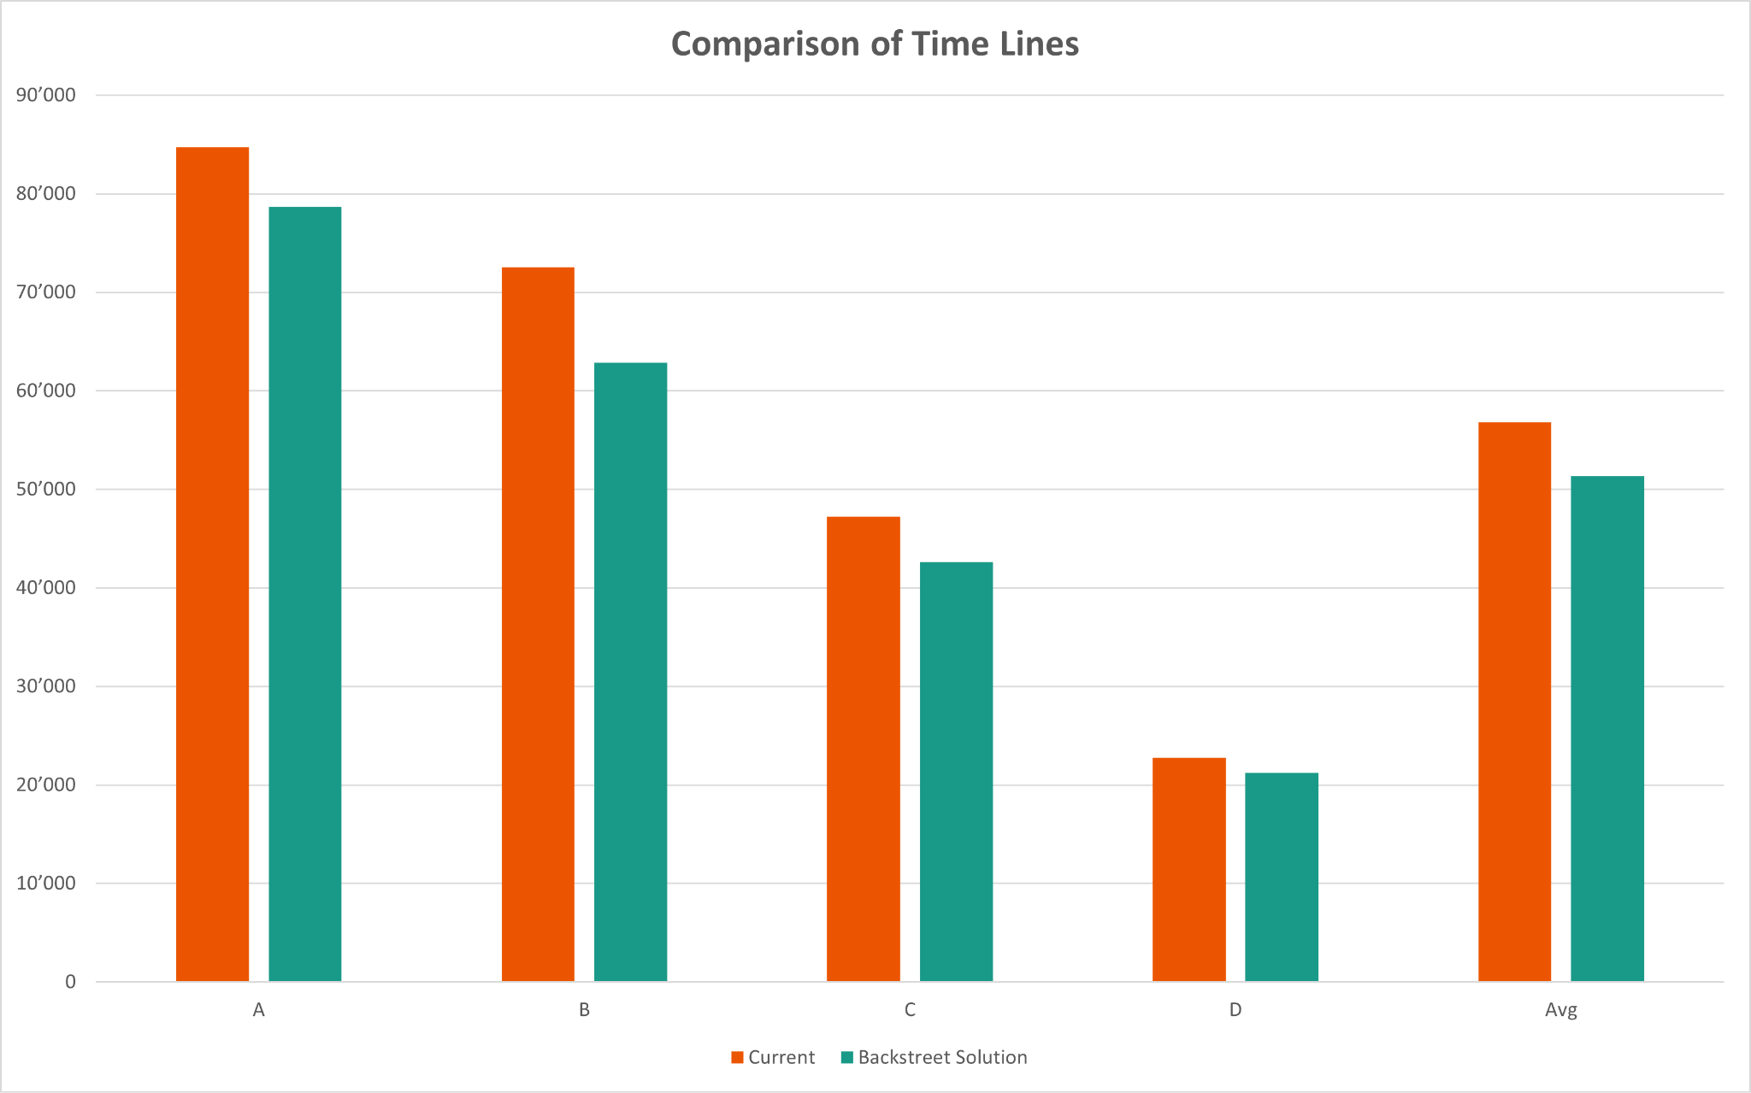
The numbers speak for themselves…
Line A | 7.11%
Line B | 13.35%
Line C | 9.81%
Line D | 6.76%
Average | 9.63%

Slide 12

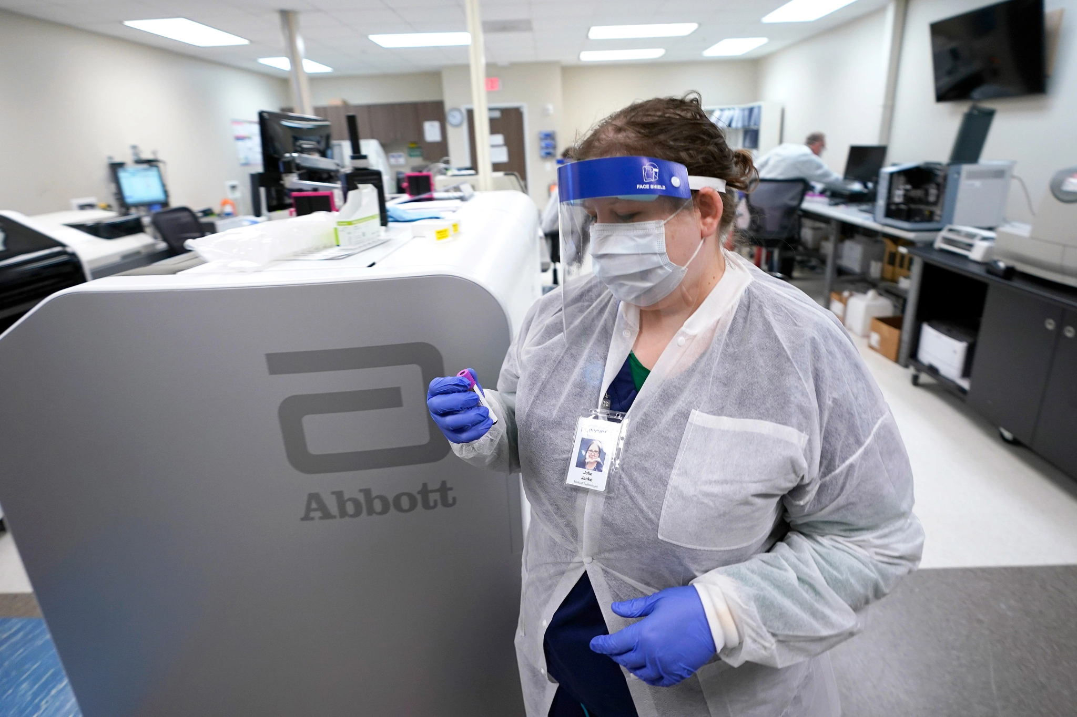
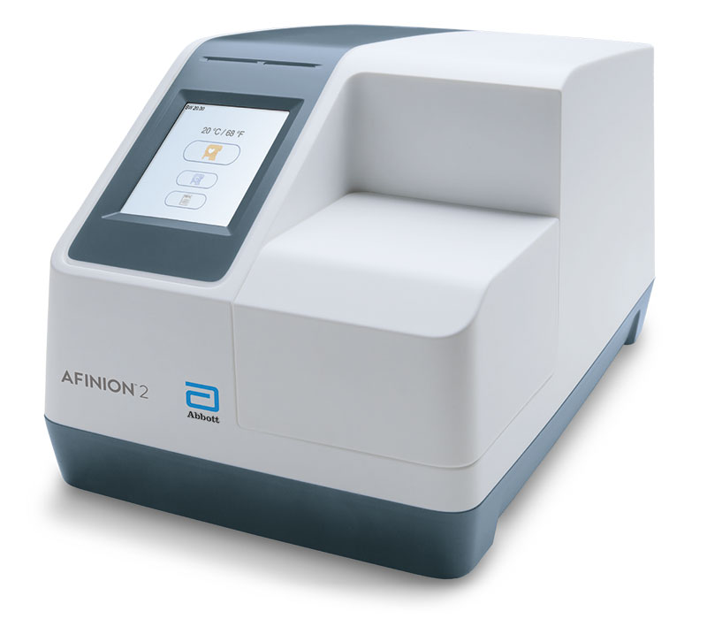
Outlook
01 | Feasibility analysis with initial calculations show good achievability
02 | Huge bottleneck effect at line D . Check parallel modules
03 | Check if it is possible to optimize the efficiency of the module
04 | Expand computing power with cloud computing
05 | Other application areas with similar optimization needs
06 | First application, other approaches also possible

Slide 13

Questions?
Thank you.
For Challenge-Master Antoine:

